Slide 1
Analysis on resort vs city hotel
Presentation by : GROUP 4
Participants:
Syeda Mubashira
Amritpal Kaur
Mariya Dubbaka
Dharma Devi Udayakumar

Slide 2
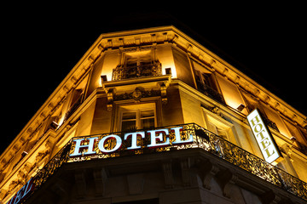
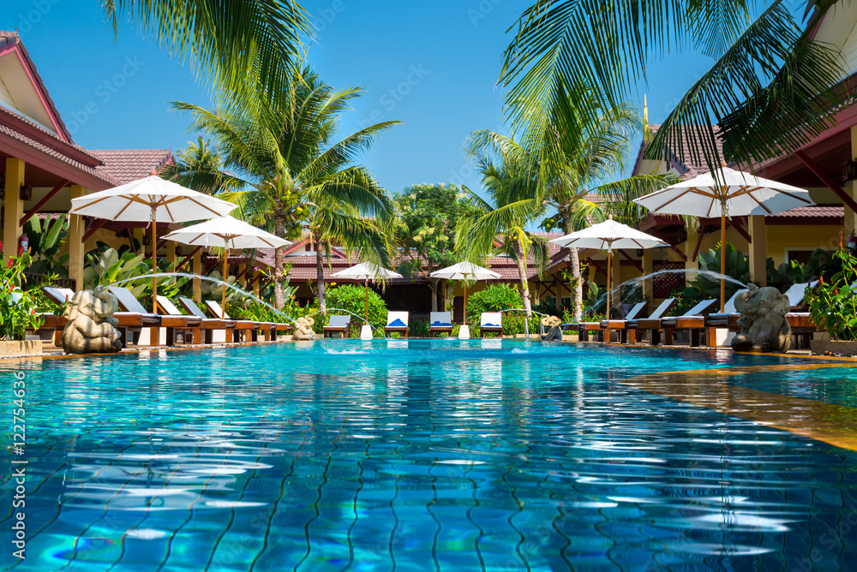
What is the main purpose of starting a business?
licensed pictures: Stock.Adobe

Slide 3
Data source:
https://www.kaggle.com/datasets/jessemostipak/hotel-booking-demand
Excel data :
Columns: 32
Number of records : 11930

Slide 4
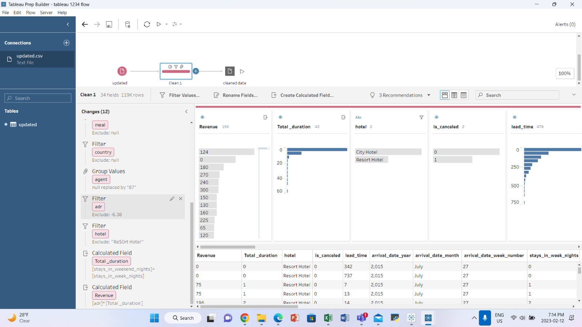

Slide 5
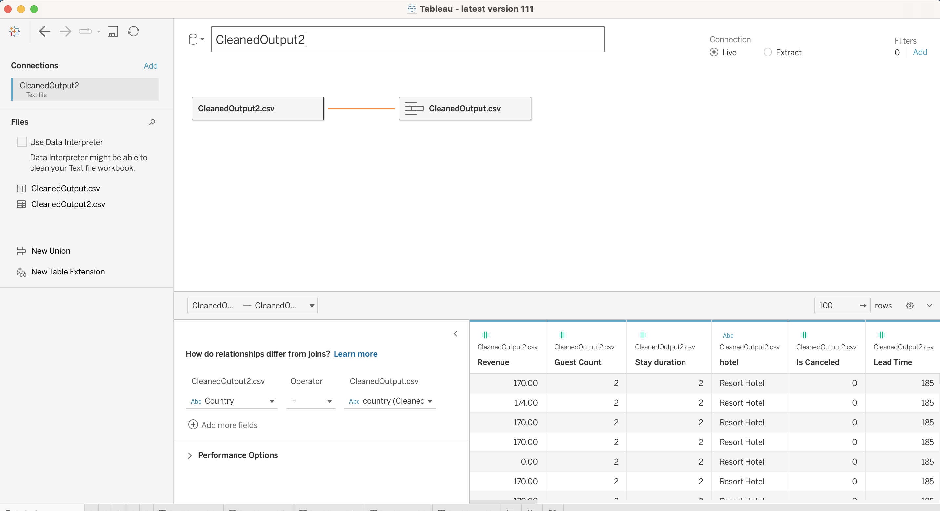

Slide 6
Visualization questions
Which hotel is generating more revenue?
What are the elements that influence the hotel revenue?
How car parking lots impact in generating the revenue?
What is the average waiting time for city hotel and resort hotel?
Which hotel is the top choice among the countries?

Slide 7
Conclusion
Based on the analysis of visualization, the investor opted for the City hotel.

Slide 8


